Slide 1

AUTOMATED IRRIGATION USING WIRELESS SENSOR NETWORK

Slide 2
Introduction
Automated irrigation using a wireless sensor network (WSN) and GPRS module is a project that aims to improve the efficiency and accuracy of irrigation systems. In traditional irrigation systems, water is often wasted due to overwatering or mismanagement of the system. By utilizing a WSN and GPRS module, this project aims to monitor the moisture levels of soil and transmit data wirelessly to a central server or control unit.
The WSN consists of a network of sensor nodes that are placed in the soil to measure the moisture levels. These nodes communicate with each other using wireless communication protocols, forming a network. The data collected by the nodes is then sent to a gateway node, which transmits the data to a central server or control unit using a GPRS module. The GPRS module uses the GSM network to send data over long distances.
The central server or control unit receives the data from the gateway node and processes it to determine the optimal irrigation schedule. The system can be configured to automatically turn on and off the irrigation system based on the moisture levels measured by the sensor nodes. This helps to prevent overwatering and ensures that the plants receive the optimal amount of water.

Slide 3
Background
Automated irrigation using wireless sensor network and GPRS module is a project that aims to optimize the use of water in agriculture. Traditional irrigation systems often rely on human intuition or manual labor to monitor and control the flow of water to crops, which can be time-consuming and inefficient.
This project proposes a solution that leverages wireless sensor networks (WSNs) and GPRS (General Packet Radio Service) technology to automate the irrigation process. WSNs are networks of small, low-power sensors that can detect changes in the environment and communicate wirelessly with each other.
The project will involve deploying a network of WSNs in a field to monitor various parameters such as soil moisture, temperature, humidity, and light intensity. The data collected by the sensors will be transmitted to a central controller using GPRS technology, which allows for real-time communication over a cellular network.
The central controller will use the data from the sensors to make decisions about when and how much water to deliver to the crops. This can help to reduce water waste by only irrigating when necessary and ensuring that the crops receive the optimal amount of water. Additionally, the system can be configured to send alerts to farmers if there are any issues with the irrigation system, such as leaks or malfunctions.
Overall, this project has the potential to improve the efficiency of agriculture by automating the irrigation process and reducing water waste. It also has the added benefit of reducing the workload for farmers and enabling remote monitoring and control of the irrigation system.

Slide 4

Problem Statement
The agriculture sector is one of the largest contributors to the economy of many countries. Irrigation is a crucial factor in agricultural productivity, but traditional irrigation methods are inefficient and require significant amounts of water. Automated irrigation systems have been developed to optimize water usage, but their implementation is still limited due to high installation and maintenance costs.
To address this issue, this project proposes an automated irrigation system using a wireless sensor network and GPRS module. The system will consist of several sensor nodes placed in the field to monitor soil moisture, temperature, and humidity levels. These sensor nodes will be connected wirelessly to a central node, which will receive and process data from all sensor nodes.
The central node will use the data to determine the appropriate time and amount of water needed for irrigation. This information will be transmitted to a GPRS module, which will send commands to an irrigation system to turn on and off the water supply as per the requirements.
The proposed system will reduce water usage by providing accurate and timely irrigation to crops. The wireless sensor network will eliminate the need for manual monitoring, which will save time and resources. The GPRS module will ensure that the irrigation system can be controlled remotely, making it more efficient and reliable.

Slide 5
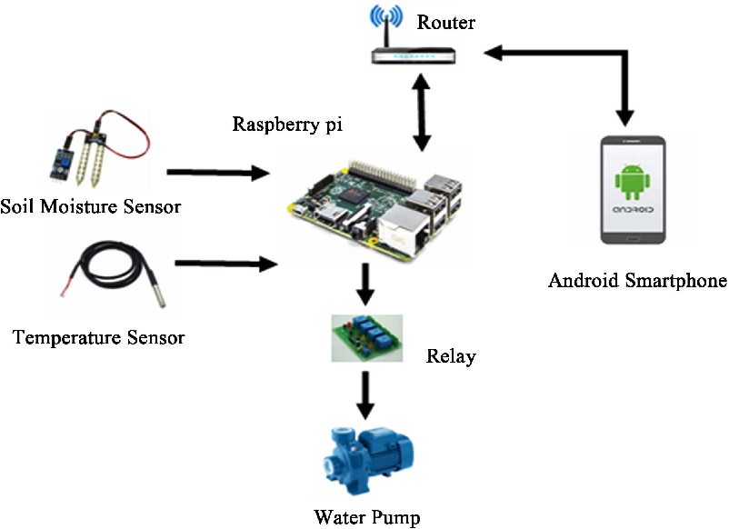

Slide 6
OBJECTIVES
Efficient water usage: The system should ensure that water is used efficiently by monitoring soil moisture, weather conditions, and other environmental factors that affect irrigation requirements.
Real-time monitoring: The system should provide real-time monitoring of soil moisture, weather conditions, and water levels to enable the farmer to make informed decisions about irrigation.
Automatic control: The system should be capable of controlling the irrigation system automatically based on the data received from the sensors.
Remote access: The system should allow remote access to the irrigation system, enabling the farmer to monitor and control the system from a remote location.
Reduced labor costs: The system should reduce the need for manual labor, as it will automate the irrigation process.
Cost-effective: The system should be cost-effective to implement and maintain, providing value for money for the farmer.
User-friendly interface: The system should have a user-friendly interface that is easy to understand and operate, even for non-technical users.
Increased crop yield: The system should ensure that the crops receive the appropriate amount of water, which will result in increased crop yield.

Slide 7
Methodology
Problem identification: Identify the need for an automated irrigation system that can optimize water usage and reduce manual labor.
Literature review: Conduct a literature review to gather information on existing irrigation systems, wireless sensor networks, and GPRS modules.
System design: Based on the literature review, design the system architecture, including the hardware and software components required for the automated irrigation system. The system should include sensors for measuring soil moisture, temperature, and humidity, a GPRS module for sending data to a central server, and a microcontroller for controlling the irrigation system.
Prototyping: Build a prototype of the automated irrigation system and test its functionality. Make any necessary modifications to the design.
System integration: Integrate the hardware and software components of the system to ensure that they work together seamlessly.
Field testing: Conduct field tests to evaluate the system's performance in real-world conditions. Measure the system's effectiveness in optimizing water usage and reducing manual labor.
Data analysis: Analyze the data collected from the system to determine its efficiency and effectiveness in managing irrigation.
Results and conclusion: Summarize the results of the project and draw conclusions about the system's effectiveness. Identify areas for future development and improvement.

Slide 8
Results &Findings
Automated irrigation systems have been designed to enhance the efficiency and effectiveness of agricultural practices. These systems are capable of monitoring the moisture levels in the soil and automatically irrigating crops when needed, thereby reducing water waste and improving crop yield.
Wireless sensor networks (WSNs) are an essential component of automated irrigation systems. They are used to gather data on soil moisture, temperature, and other environmental factors, which are transmitted wirelessly to a central control system. The GPRS module enables communication between the WSN and the central control system through the cellular network, allowing for remote monitoring and control of the irrigation system.
However, the implementation of these systems requires careful planning and design to ensure optimal performance. Factors such as the type of crops, soil type, and climate must be taken into consideration when designing the system. Maintenance and calibration of the sensors are also important to ensure accurate data collection.
In summary, automated irrigation systems using WSNs and GPRS modules have shown promising results in improving agricultural practices. However, careful planning, design, and maintenance are necessary to ensure optimal performance.

Slide 9

Conclusion
Based on the results of the project, it can be concluded that automated irrigation using wireless sensor network and GPRS module is a viable solution for improving irrigation efficiency and reducing water wastage. The system is capable of accurately measuring soil moisture levels and sending real-time data to the central control unit, which can then adjust the irrigation schedule based on the needs of the plants.
The use of wireless sensor network and GPRS module ensures that the system is able to operate seamlessly over a large area, providing a cost-effective and efficient solution for farmers. Additionally, the system is designed to be easy to install and maintain, which further increases its practicality and usability.
Overall, the project has demonstrated the potential of using modern technology to improve agriculture and reduce environmental impact. By reducing water wastage and improving crop yields, automated irrigation using wireless sensor network and GPRS module can help to create a more sustainable future for agriculture.

Slide 10




REFERENCES
https://circuitdigest.com/microcontroller-projects/automatic-irrigation-system-using-arduino-uno
https://www.researchgate.net/publication/260303884_Automated_Irrigation_System_Using_a_Wireless_Sensor_Network_and_GPRS_Module
https://projecthub.arduino.cc/
OLD PROJECT RESEARCH THESIS
MATERIALS PROVIDED BY OUR FACULTY GUIDE

Slide 11


FUTURE WORKS

Slide 12
Integrate AI and Machine Learning: Implementing AI and machine learning algorithms can help optimize the irrigation process by predicting the amount of water required by crops and adjusting the irrigation system accordingly.
Implement a smart control system: A smart control system can be implemented to monitor and control the irrigation system from a remote location, using a mobile application or web interface.
Expand the system to cover a larger area: If the current project covers a small area, consider expanding the system to cover a larger area. This can be achieved by adding more sensors and GPRS modules.
Use alternative sources of energy: Consider using alternative sources of energy, such as solar power, to power the irrigation system. This can help reduce the system's dependence on electricity.
Improve the accuracy of sensors: The accuracy of sensors used in the project can be improved by upgrading them to more advanced sensors with higher accuracy and precision.
Implement a fault detection and notification system: Implementing a fault detection and notification system can help identify faults in the irrigation system and notify the user via email or SMS.
Implement a data analytics system: A data analytics system can be implemented to collect and analyze data from the sensors and GPRS module. This can help identify patterns and trends in the irrigation process, which can be used to optimize the system.
Consider adding a weather monitoring system: A weather monitoring system can be integrated with the irrigation system to automatically adjust the irrigation schedule based on weather conditions.

Slide 13
CODE
void send_sms(int k)
{
gsm_Serial.println("Sending SMS...");
gsm_Serial.println("AT");
delay(1000);
gsm_Serial.println("ATE0");
delay(1000);
gsm_Serial.println("AT+CMGF=1");
delay(1000);
gsm_Serial.print("AT+CMGS=\"9885185546\"\r\n");// Replace x with mobile number
delay(1000);
gsm_Serial.println("ABNORMAL FIELD CONDITIONS ");
if(k==1)
gsm_Serial.print("TANK LEVEL IS LOW AT FIELD");
if(k==2)
gsm_Serial.print("MOISTURE CONTENT IS HIGH AT FILED");
if(k==3)
gsm_Serial.print("MOISTURE CONTENT IS LOW AT FILED");
if(k==4)
gsm_Serial.print("TANK LEVEL IS HIGH AT FIELD");
//gsm_Serial.println("https://www.google.com/maps/search/?api=1&query=" + String(16.4419)+ "," + String(80.6226));
delay(100);
gsm_Serial.println((char)26);// ASCII code of CTRL+Z
delay(6000);
gsm_Serial.println("AT");
delay(1000);
gsm_Serial.println("ATE0");
delay(1000);
gsm_Serial.println("AT+CMGF=1");
delay(1000);
gsm_Serial.print("AT+CMGS=\"8247699676\"\r\n");// Replace x with mobile number
delay(1000);
oid setup() {
lcd.begin(16,2);
lcd.print(" WELCOME");
lcd.setCursor(0,1);
lcd.print("INITIALIZING");
delay(1500);
lcd.clear();
dht.begin();
Serial.begin(9600);
gsm_Serial.begin(9600);
gsm_Serial.println("AT");
delay(1500);
gsm_Serial.println("AT+CMGF=1");
pinMode(pingPin,OUTPUT);
pinMode(echoPin,INPUT);
pinMode(ms,INPUT);
pinMode(m1,OUTPUT);
pinMode(m2,OUTPUT);
pinMode(m3,OUTPUT);
pinMode(m4,OUTPUT);
pinMode(buz,OUTPUT);
}
void loop()
{
delay(200);
int t = dht.readTemperature();
int h=dht.readHumidity();
int mval=analogRead(ms);
digitalWrite(pingPin, LOW);
delayMicroseconds(2);
digitalWrite(pingPin, HIGH);
delayMicroseconds(10);
digitalWrite(pingPin, LOW);
duration = pulseIn(echoPin, HIGH);
distance=duration*0.034/2;
Serial.println("D:");
Serial.println(distance);
Serial.println("T:");
Serial.println(t);
Serial.println("H:");
Serial.println(h);
Serial.println("M:");
Serial.println(mval);
delay(500);

Slide 14
Thank You

